Slide 1
EN 410 Energy Management
Gurubalan Annadurai
guru.a@iitb.ac.in

Slide 2
Cogeneration
Many industries require energy input in the form of heat, called process heat. Process heat in these industries is usually supplied by steam
Industries that use large amounts of process heat also consume a large amount of electric power.
The result is a plant that produces electricity while meeting the process-heat requirements of certain industrial processes (cogeneration plant)
Cogeneration: The production of more than one useful form of energy (such as process heat and electric power) from the same energy source.

Slide 3
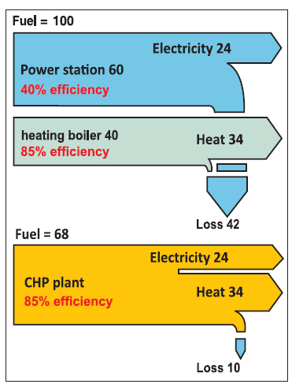
Cogeneration
Higher efficiency – lesser fuel – lesser loss – lesser pollution
A combination of power production and heating/cooling can also be used in a cogeneration scheme.
It is called trigeneration if three useful forms of energy (such as electric power, process heat, and cooling) are produced from the same energy source.

Slide 4
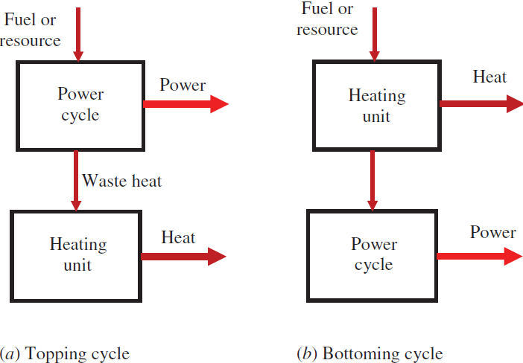
Cogeneration Schemes
Topping cycle is most commonly used. It is particularly suitable when the electric demand of the facility is greater than the thermal demand, and the process heat temperature requirements are not high.
Bottoming cyle is particularly suitable when the plant needs process heat at a high temperature. Some examples include steel reheat furnaces, clay and glass kilns and aluminum remelt furnaces.
The power cycle is also called prime mover.
Steam-turbine (Rankine) cycle, a gas-turbine (Brayton) cycle, a combined cycle (combination of Rankine and Brayton cycles), an internal combustion engine

Slide 5
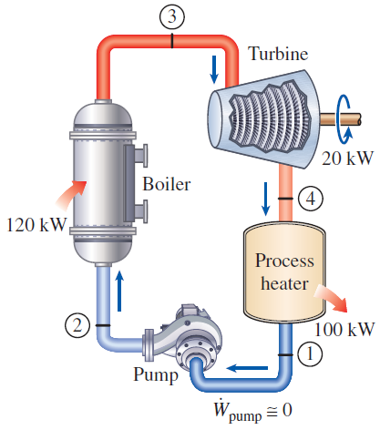
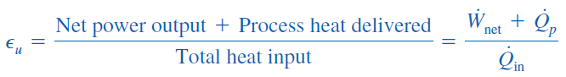
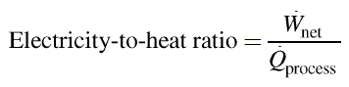
Steam-turbıne cogeneratıon
Utilization factor
Ideal since not suitable for load variation

Slide 6
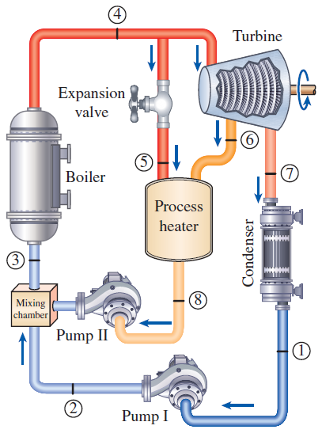
Cogeneration plant with adjustable loads
At times of high demand for process heat, all the steam is routed to the process-heating units and none to the condenser (m₇= 0). The waste heat is zero in this mode.
If this is not sufficient, some steam leaving the boiler is throttled by an expansion or pressure-reducing valve and directed to the process-heating unit.
Maximum process heating is realized when all the steam leaving the boiler passes through the valve (m₅= m₄). No power is produced in this mode.
When there is no demand for process heat, all the steam passes through the turbine and the condenser (m₅=m₆=0), and the cogeneration plant operates as an ordinary steam power plant.

Slide 7
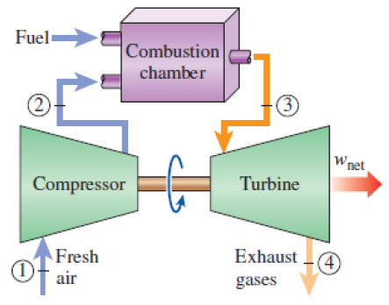
Gas-turbıne cogeneratıon
Heat is rejected to the atmosphere at a high temperature (300 to 400°C) which makes this plant very suitable for cogeneration applications.
Steam is usually taken at an intermediate stage in the turbine or from the outlet of the boiler so that the temperature is sufficiently high for process heating.
Multiple process heating at high temperature
Advantages : Simpler, easier and quicker to install and operate, and cheaper compared to steam power based cogeneration.

Slide 8
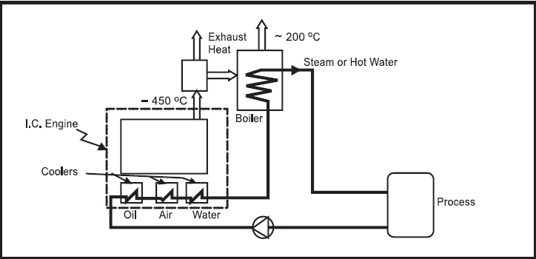
Dıesel-engıne cogeneratıon
Fuel: relatively inexpensive heavy fuel oil, a low-grade product of oil refineries. Natural gas is also used.
Set up time: Diesel engine power plants can be set up quickly, normally in less than 12 months, to generate hundreds of megawatts of power.
Power capacity: Reciprocation engines are mostly employed in low and medium power generation units. 50 kW to 10 MW - natural gas, 50 kW to 50 MW - light diesel fuel, 2.5 MW to 50MW - heavy fuel oil
Sources of waste heat: Exhaust gas, engine jacket cooling water, lube oil cooling water, and turbocharger intercooling
Hot water and steam production: Recovered heat is generally in the form of hot water or low pressure steam (about 2 bar). The high temperature exhaust gas can generate medium pressure steam (about 10 bar).

Slide 9
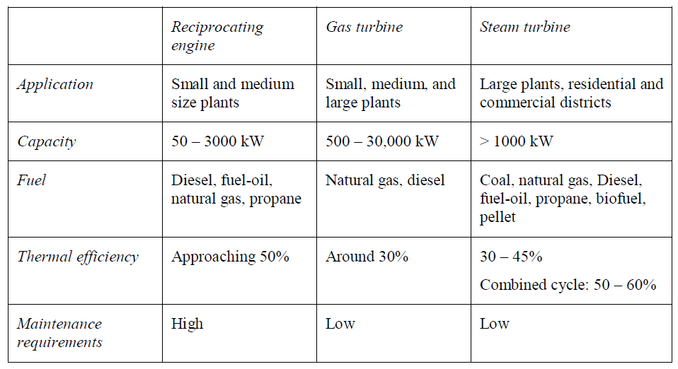
Selection of prime movers

Slide 10
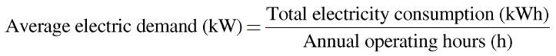
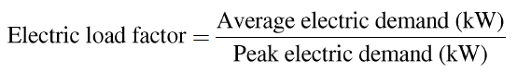
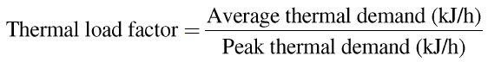
Load Factor
Electricity and heat use: A preliminary investigation of a proposed cogeneration application should start with the analysis of plant’s energy use profile. The upper and lower limits of electricity and heat use of the facility should be analyzed.

Slide 11
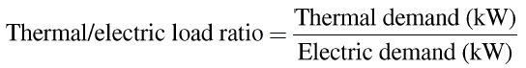
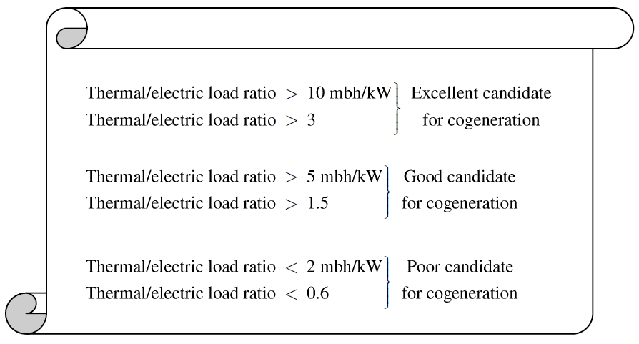
Thermal/electric load ratio
1 mbh = 1000 Btu/h
A high value of thermal/electric load ratio corresponds to a higher utilization factor for a given cogeneration system.

Slide 12
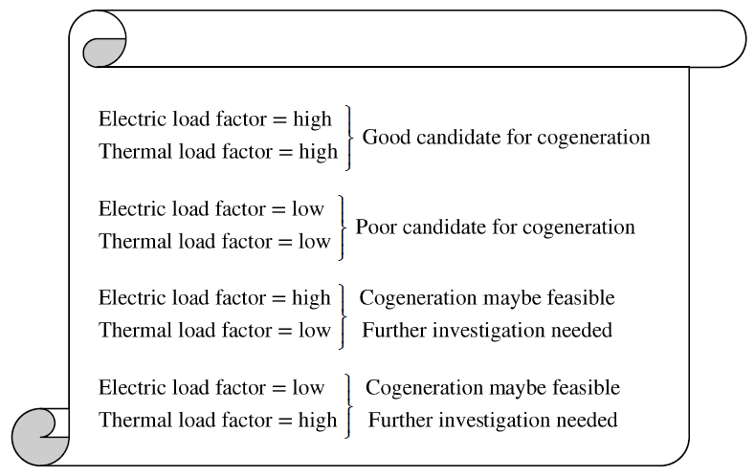
Load Factor
A high load factor is preferred for cogeneration applications as it represents the greater use of installed capacity.
A low load factor (e.g. 40%) means that if the cogeneration electricity capacity is selected based on the peak demand, the system will supply on average 40% of the installed capacity most of the time and close to full capacity for only a short period of time over a year.

Slide 13
Load Factor
If the electric load factor is high and the thermal load factor is low:
A cogeneration application can still be feasible provided that additional heat demand can be supplied from a backup boiler.
A plant may have a low thermal load factor when the boiler shuts down during a certain season (summer, no space heating)
If the electric load factor is low and the thermal load factor is high:
A cogeneration application can still be feasible provided that additional electric demand can be purchased from the utility at a reasonable price.
In this case, the voltage transformation and associated equipment cost may have to be taken care of by the plant.

Slide 14
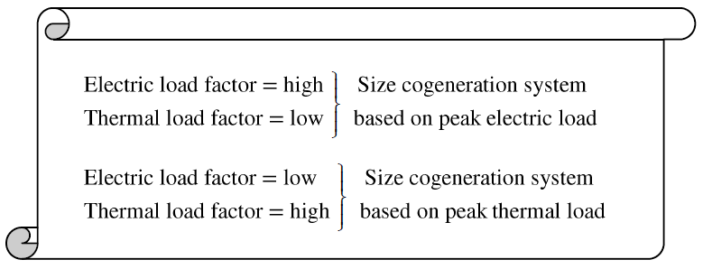
Sizing
Electric dispatch
Thermal dispatch
When both electric and heat load factors are high, the sizing of the system should be based on
- peak electric demand
if the use of a backup boiler is feasible.
- peak thermal demand
if the selling surplus electricity to utility is feasible.
Thermal dispatch is more economical than electrical dispatch

Slide 15
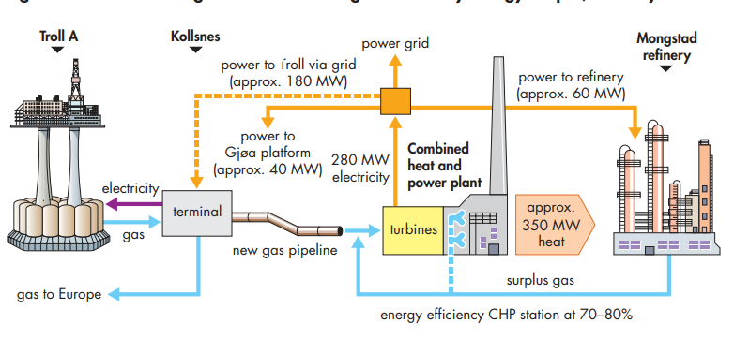
Case Study: Mongstad refinery energy project, Norway

Slide 16
Steam-turbıne cogeneratıon
A textile plant requires 4 kg/s of saturated steam at 2 MPa, which is extracted from the turbine of a cogeneration plant. Steam enters the turbine at 8 MPa and 500°C at a rate of 11 kg/s and leaves at 20 kPa. The extracted steam leaves the process heater as a saturated liquid and mixes with the feedwater at constant pressure. The mixture is pumped to the boiler pressure. Assuming an isentropic efficiency of 88% for the turbine, determine (a) the rate of process heat supply, (b) the net power output, and (c) the utilization factor of the plant and the electricity-to-heat ratio.

Slide 17
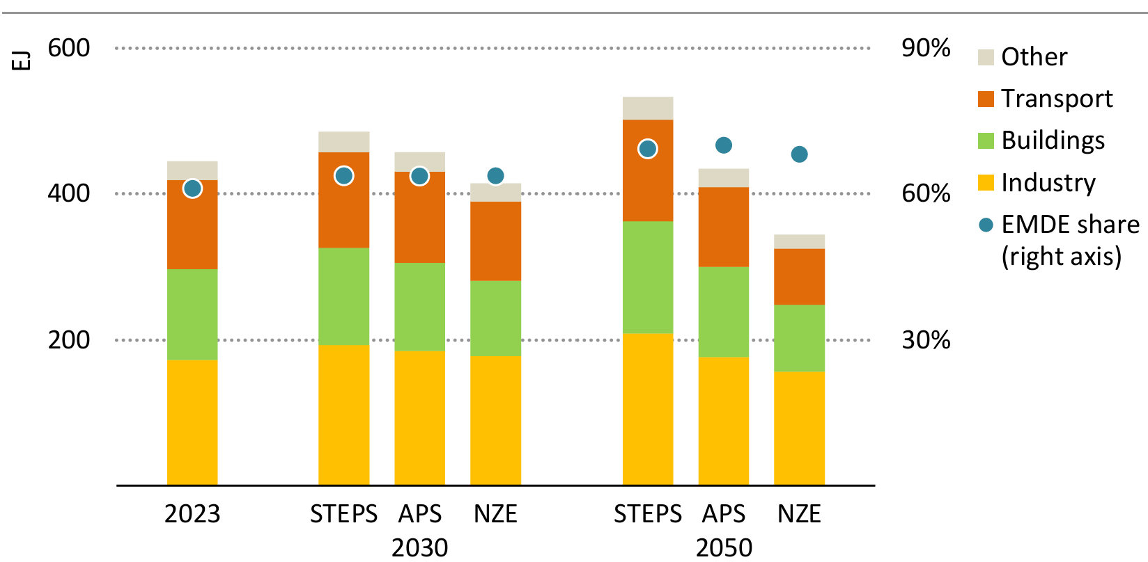
Energy demand across sectors

Slide 18
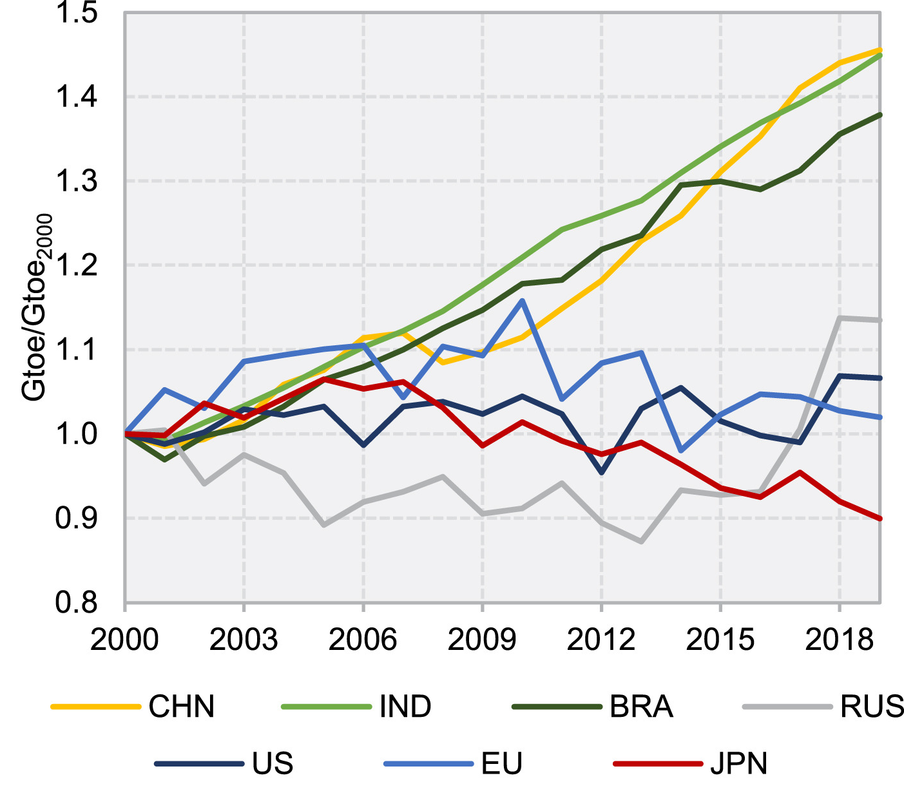

Why India?

Slide 19
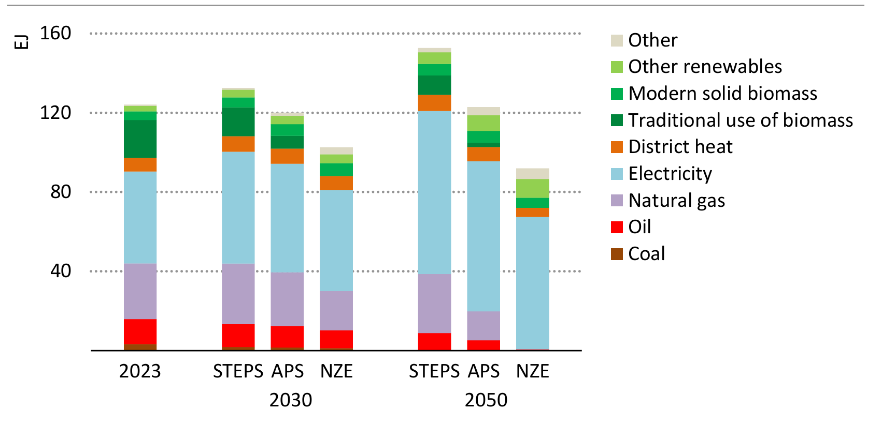
Building energy demand
What is the problem

Slide 20
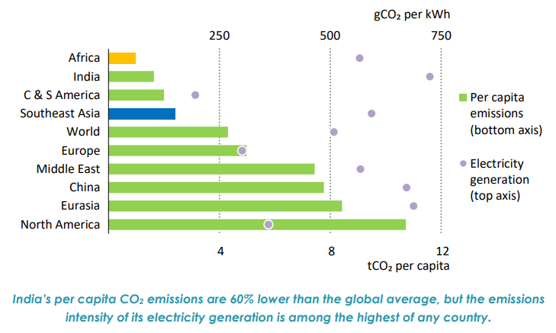
Why India?

Slide 21
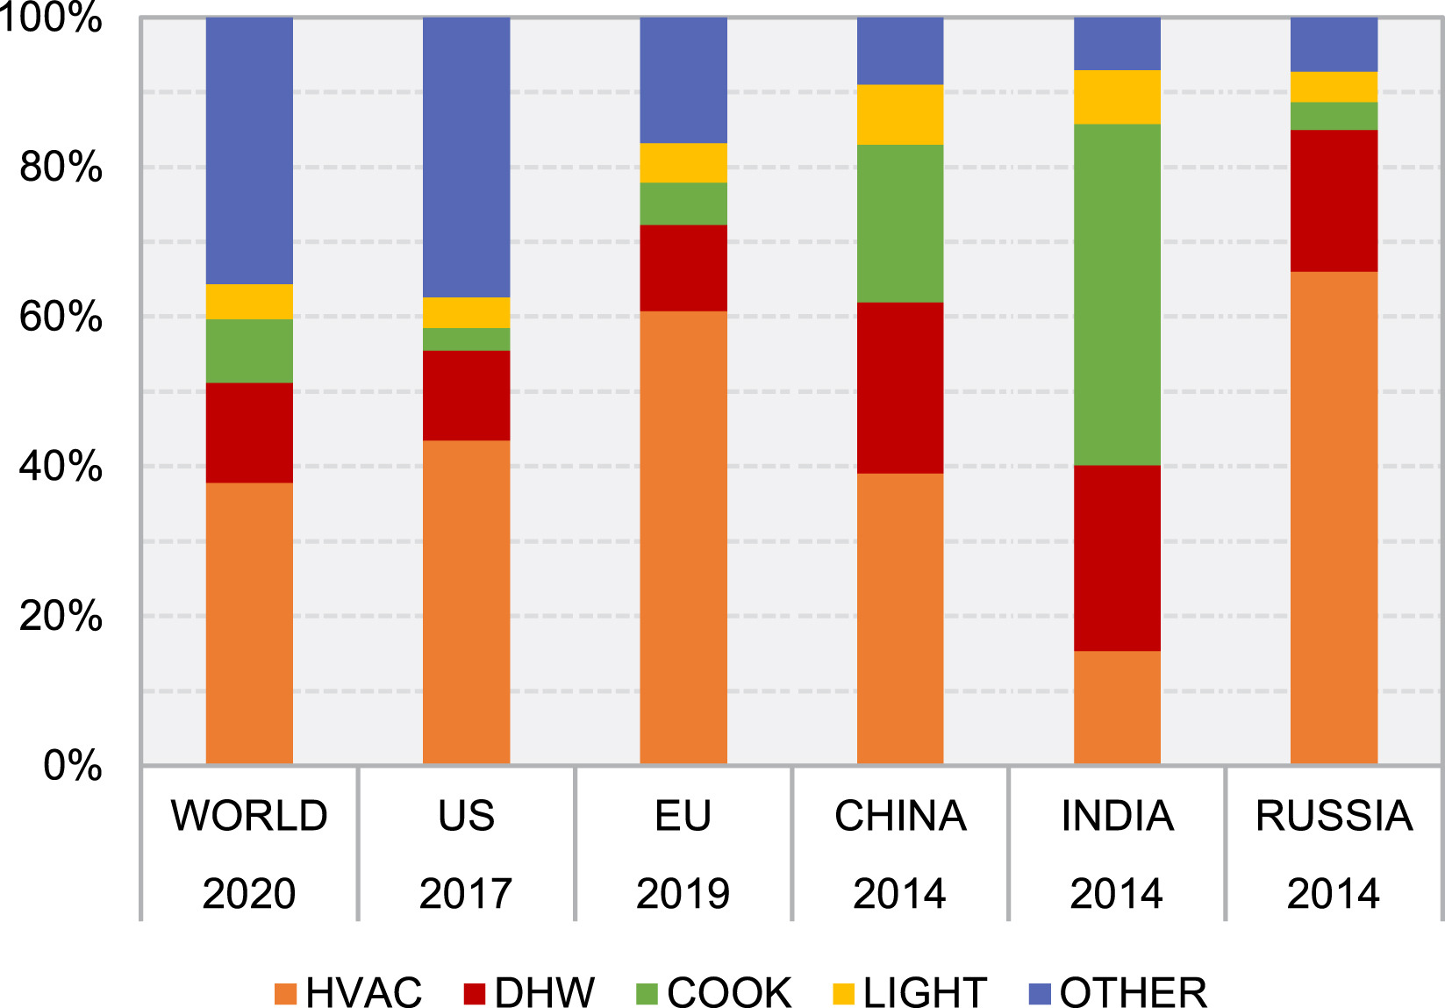
End use intensity global and across countries

Slide 22
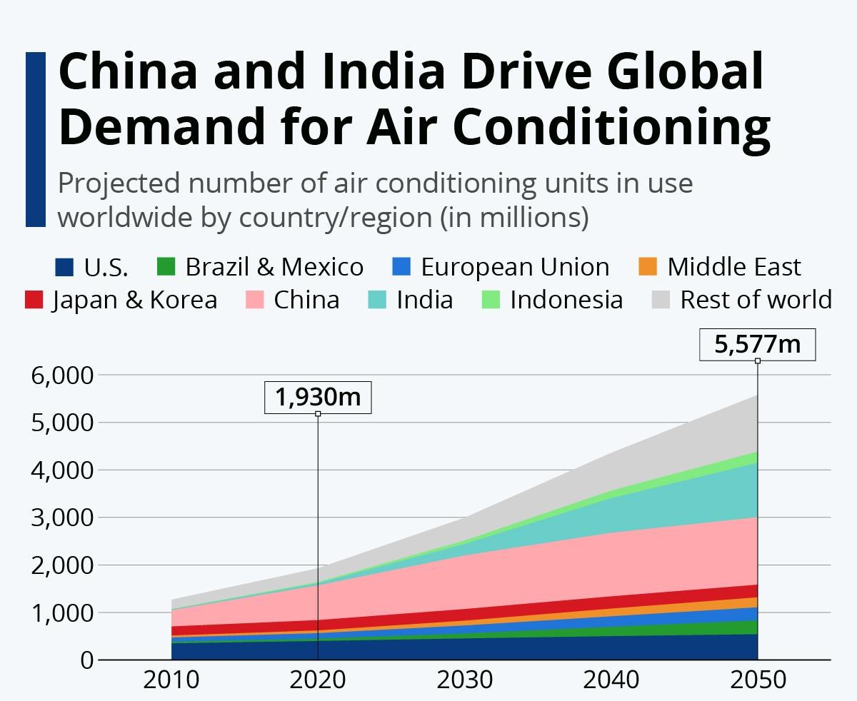
HVAC systems
World's air conditioners and fans – 10% global electricity consumption.
Energy demand for space cooling has risen at an average pace of 4% per year since 2000, twice as quickly as for lighting or water heating
Higher energy consumption for space cooling particularly affects peak electricity demand, especially during hot days when equipment is used at full capacity.

Slide 23
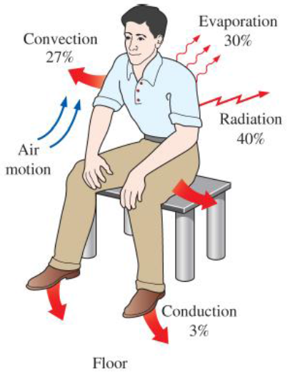
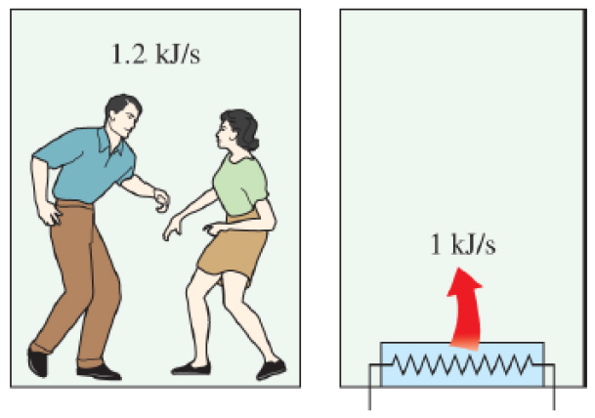

Why we need HVAC system?
Most animals come into this world with built-in insulation, but human beings come with a delicate skin.
Two fast-dancing people supply more heat to a room than a 1-kW resistance heater.
Mechanisms of heat loss from the human body and relative magnitudes for a resting person.

Slide 24
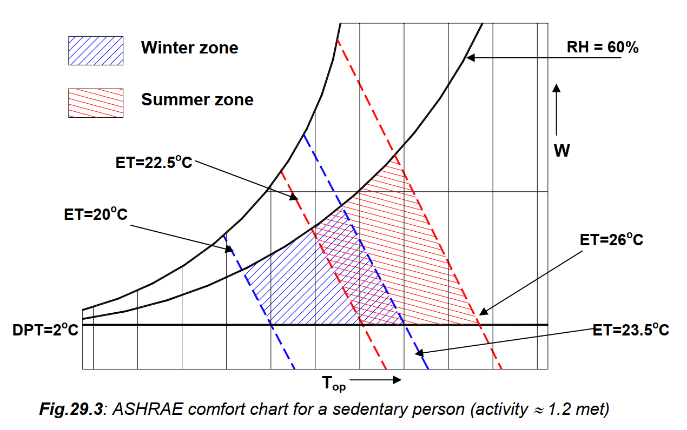
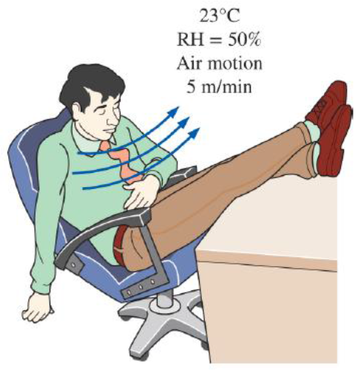
Comfort Chart
A thermally comfortable environment.

Slide 25
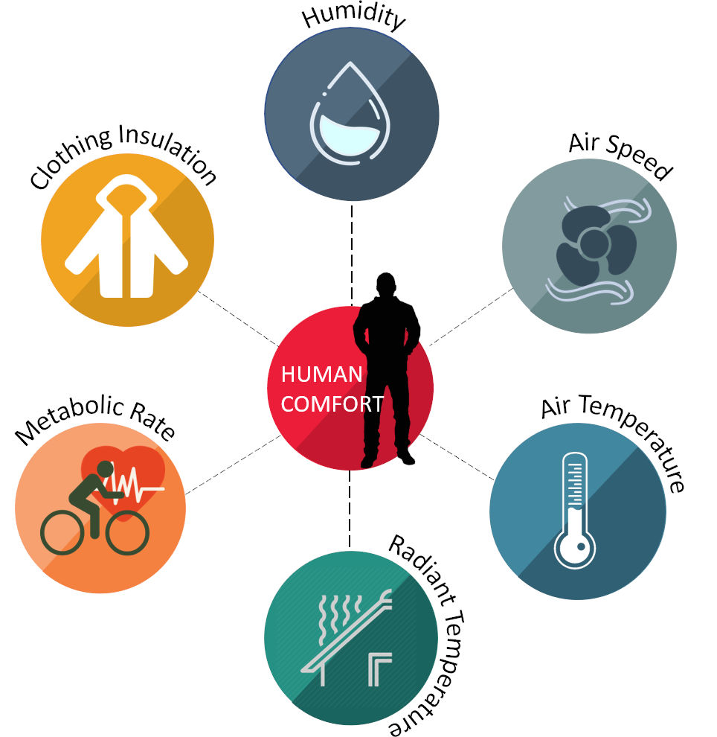
Thermal comfort

Slide 26
Purpose of HVAC system
The purpose of comfort air conditioning is to provide an artificial environment in a given volume irrespective of ambient conditions as required for comfort and welfare of occupants by controlling dry-bulb temperature (DBT), humidity, air movement, cleanliness, noise level, etc.

Slide 27
Refences
Introduction to Pinch Technology, Rokni, Masoud, DTU
https://www.youtube.com/watch?v=MQejghnZj_w&list=PL_UhBh-E8IOLmkctKJng1EmQru3RDZyV7&index=8

Slide 28
